Slide 1
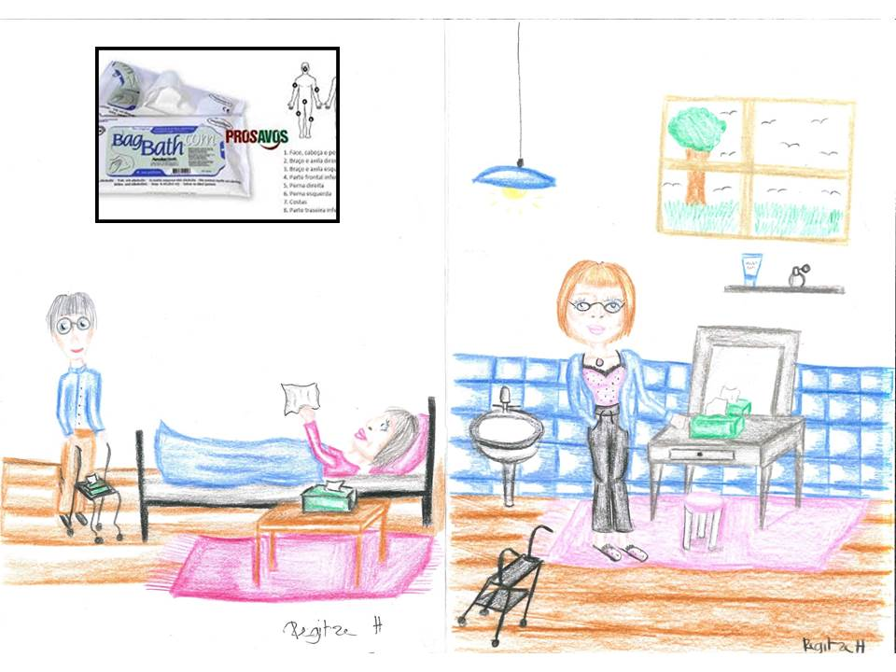
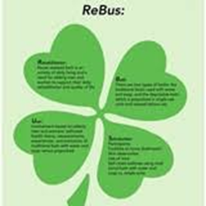
ReBUS: Coaching to selfcare- Older Patients in Need of Help with Personal Hygiene in Home Care Setting - Students Involvement and Participation in Research
https://www.diakonissestiftelsen.dk/sygeplejerske/rebus-kronologi

Slide 2
Presentation:
Troels Krarup Frandsen – Clinical Advicer, RN, UCD
Rikke Volmer Brandsen – Supervicor Municipality of Frederikberg Home Care Setting
Britta Hørdam – Head of Research Programme: Coaching to Selvfcare, UCD

Slide 3
Aim of Research To study and compare older adults’ attitudes and selfreported experiences by using traditional bath vithe soap and water versus pre-packed wash-cloths to their daily nurse assisted bath in a home care setting. 4. steps: 1.Collecting date – 2. Analyzing data -3. Implementation – 4. Publishing articles, peer review, 2 study-books

Slide 4
Methods: Descriptive study in a crossover design Results: Both the patients and the nurses preferred prepacked wash-cloths – and furthermore the patients preferred to have their own choice of bath type.

Slide 5
Students Involvement in Research activities
Students:a total of 30 participated/20 health care assistents
Journal clubs:26 students in groups of 3-4
Systematic reviews: 24 students in smaller groups
Writing articles in Danish: 12 students/6 Journals
Bachelor project: 2 students
Peer review articles in English:2 students/2 Journals
Implementation: 2 students and 13 health care assistents
Visiting factory producing prepacked wash-cloths: 25

Slide 6
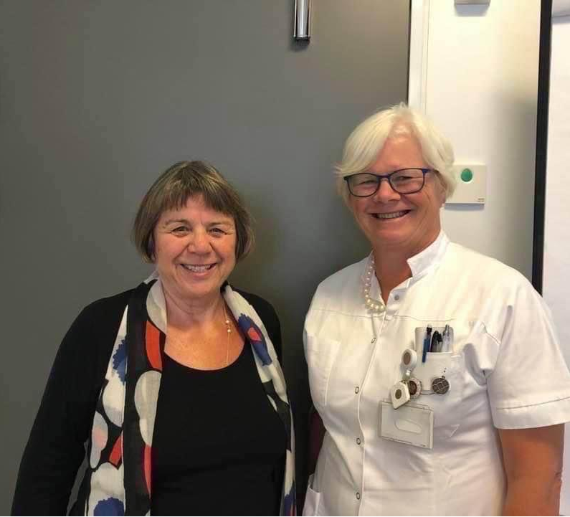
Study-books

Slide 7
Journal Club
Sheppard CM, Brenner PS. The effects of bathing and skin care practices on skin quality and satisfaction with an innovative product. J Geron- tol Nurs 2000; 26: 36.
Nøddeskou L et al. Elderly patients’ and nurses’ assessement of traditional bath compared to prepacked single units – randomized clinical trial. I: Scand J Caring SCI: 2015; 29 (347-352)
Skewes SM. No more bed baths!... bag bath... a technique that lessens the risk of skin impairment. RN 1994; 57: 34–5.
Lawlwer J: Behind the screens: nursing, somology, and the problem of body. New York: Livingstone; 1994

Slide 8
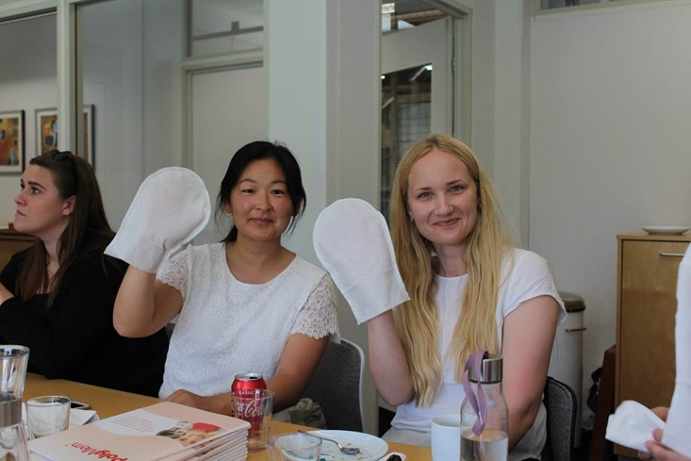
Factory visits: From soap to wash-cloths to wash-glove

Slide 9
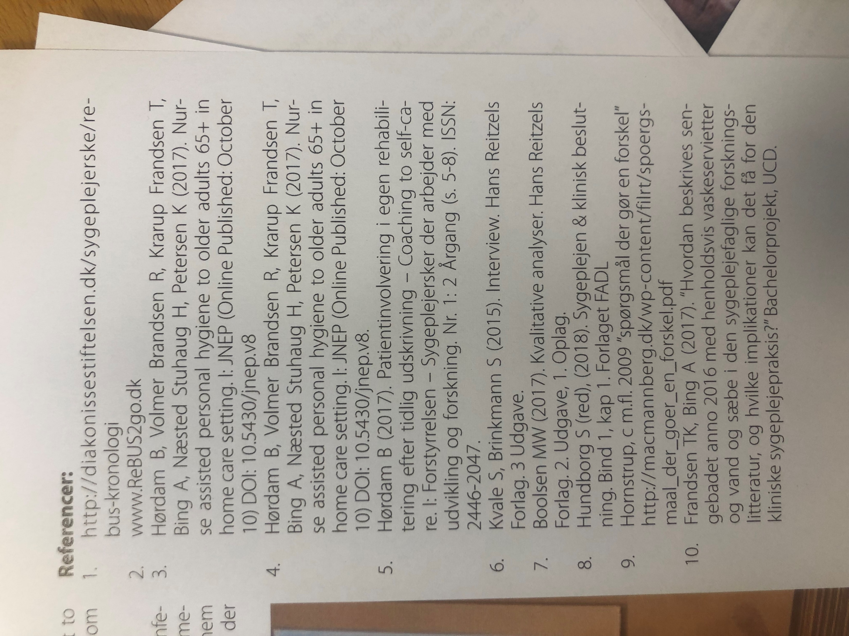
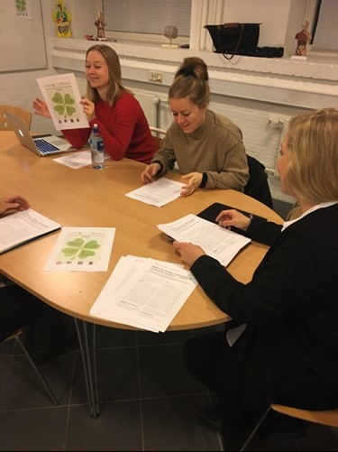
Reflection room

Slide 10
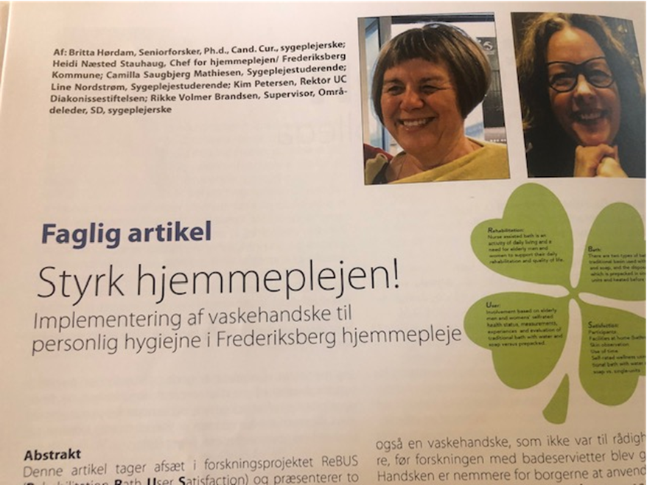
Journal of Development and Research/Peer review

Slide 11
ReBUS =Rehabilitation Bath User Satisfaction ).

Slide 12
Writing papers – Journal of Education news

Slide 13
Systematic review- follow up- interview
Staff’s conclusion
we have a strong focus on evidence and research-based knowledge in the study, so now I have also gained an insight into how to do research in practice
my patient who is terminal, he enjoys the warm glove and prefer that he can participate in the personal care

Slide 15
Clinical Research: Citizen-centered nursing for the elderly in home care setting – Troels and Rikke

Slide 16
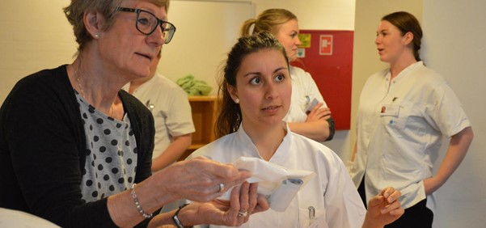
Thank you for your attention !
Thank You for Your Attention !
We are ready for quistions and discussion!
www.diakonissestiftelsen.dk/sygeplejerske/rebus-kronologi

